Slide 1

BATCH 93

Slide 2
TRAIN RESERVATION SYSTEM
Presented By-
YASHRAJ CHOUHAN (6406)
SAMARTH KUMAR(6407)
RAVI KUMAR(6408)
SIVA SANTOSH (6410)

Slide 3
CONTENTS
INTRODUCTION
PROBLEM STATEMENT
SYSTEM DESIGN
TECHNOLOGY
RESULTS
CONCLUSION
FUTURE ENHANCEMENT

Slide 4
INTRODUCTION
The Train Reservation system makes it possible for the passengers to book a ticket easily.
The tickets would be booked on the basis of the source and the destination of the journey.
This project focuses on designing and developing a database capable of maintaining different records of various trains.
Automatically a ticket is generated in the end including the details of the passengers regarding the journey.

Slide 5
PROBLEM STATEMENT
There is lack of Reservation Counters available for the travelers to book a ticket.
It is a time consuming as well as a tedious process for the passengers to book tickets as they have to either travel long distances or they have to stand in long queue.
Services provided by the Reservation Counters at the station suffer during rush hours, therefore leading to hectic conditions for the passengers.

Slide 6
SYSTEM DESIGN
Browser
Controller layer
Service layer
Repository/ DOA layer
Database
View
Home
User login
Admin
Login
Train details
Add Passenger
Add Train
Add Ticket
User
Add passenger
Passenger
Train details
Train tickets
Valid user
Yes
Book ticket
Add/Update information
Add/Delete/Update
Print
No
Register

Slide 7



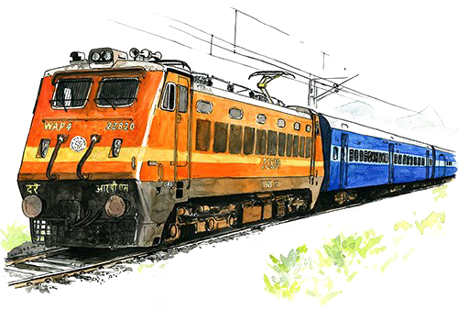


TECHNOLOGIES USED
Eclipse IDE
VS Code
HTML5
CSS3
MYSQL

Slide 8
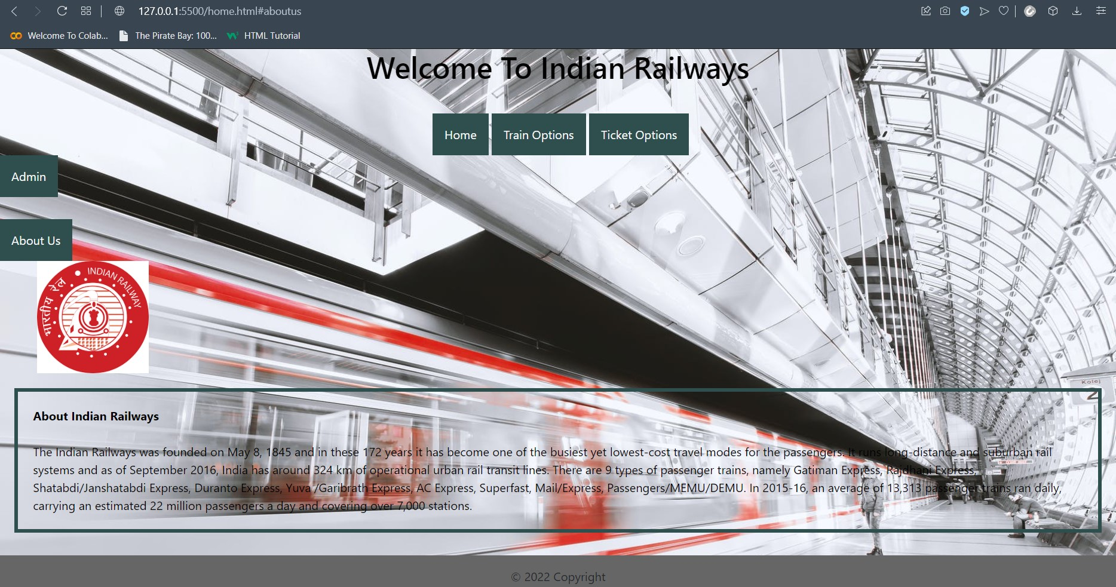
RESULT

Slide 9
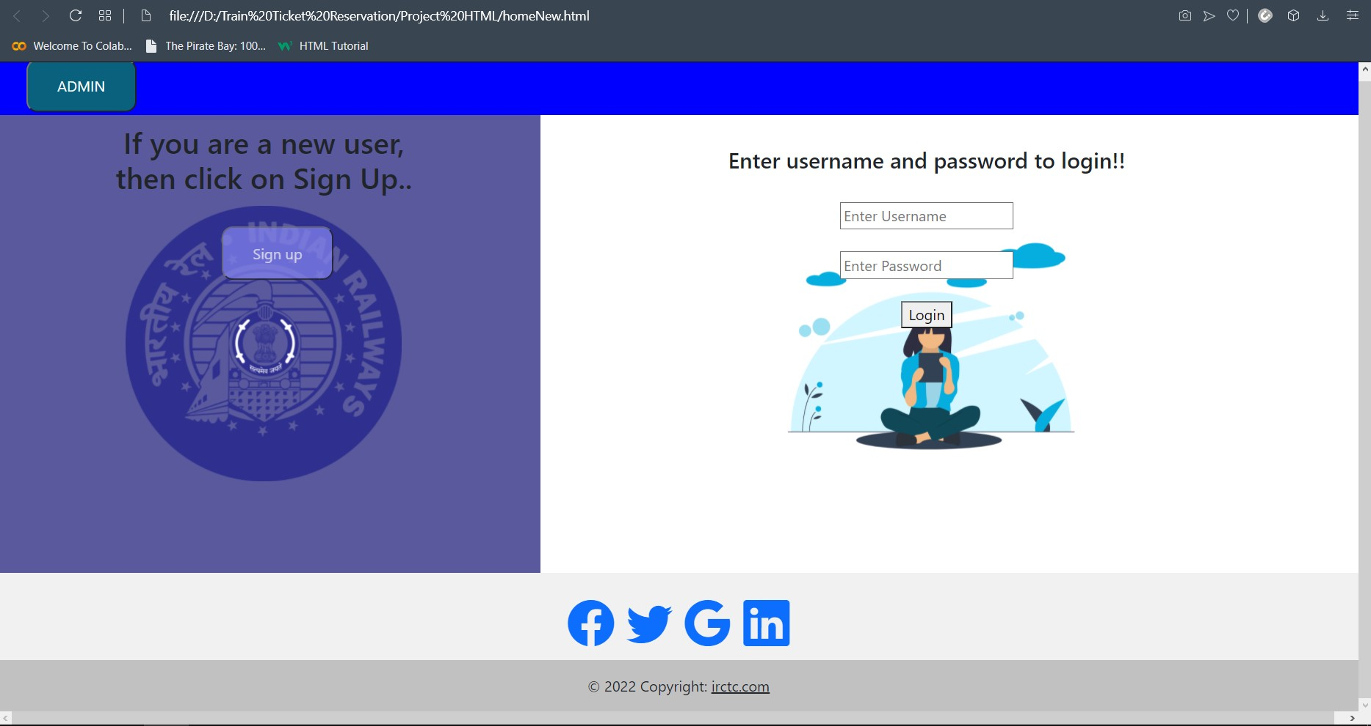

Slide 10
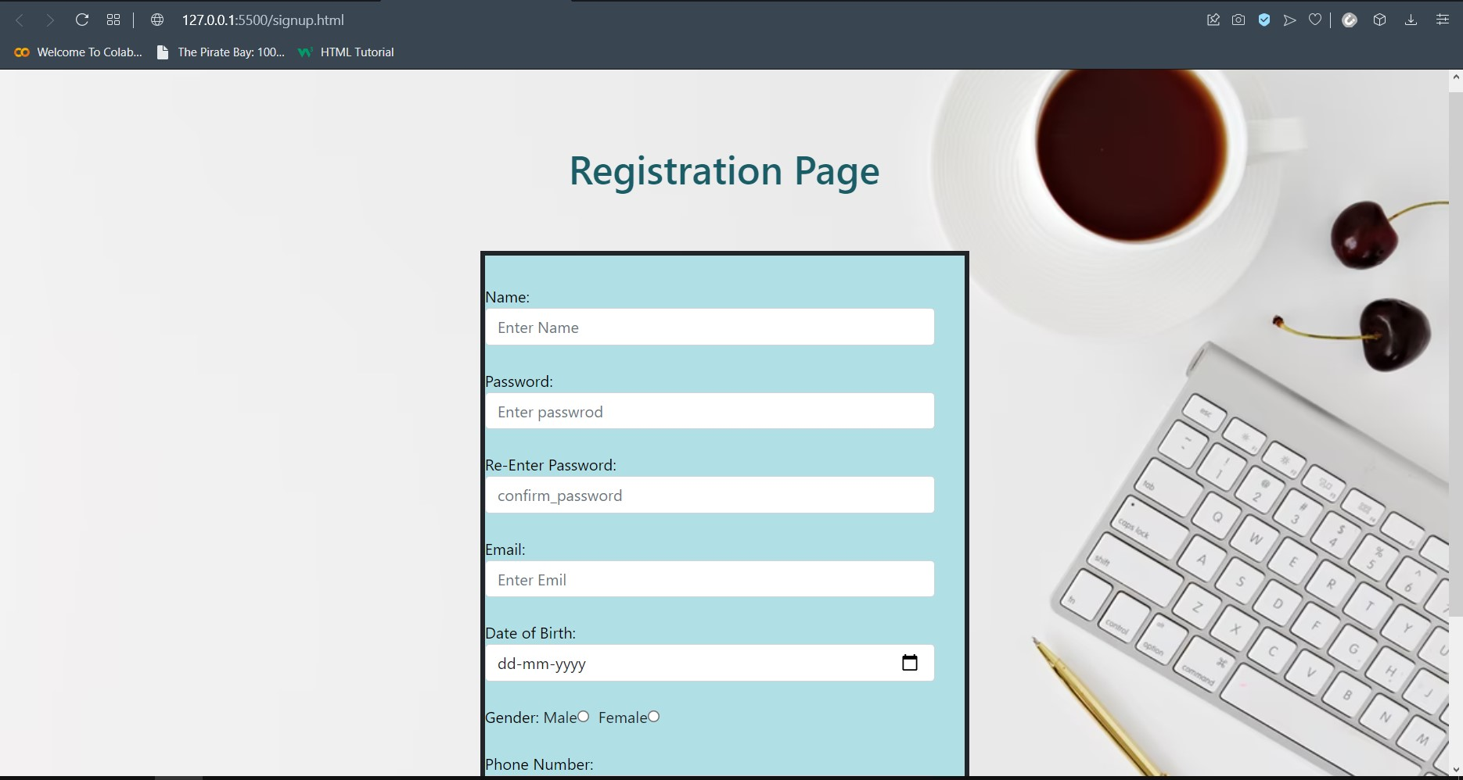

Slide 11
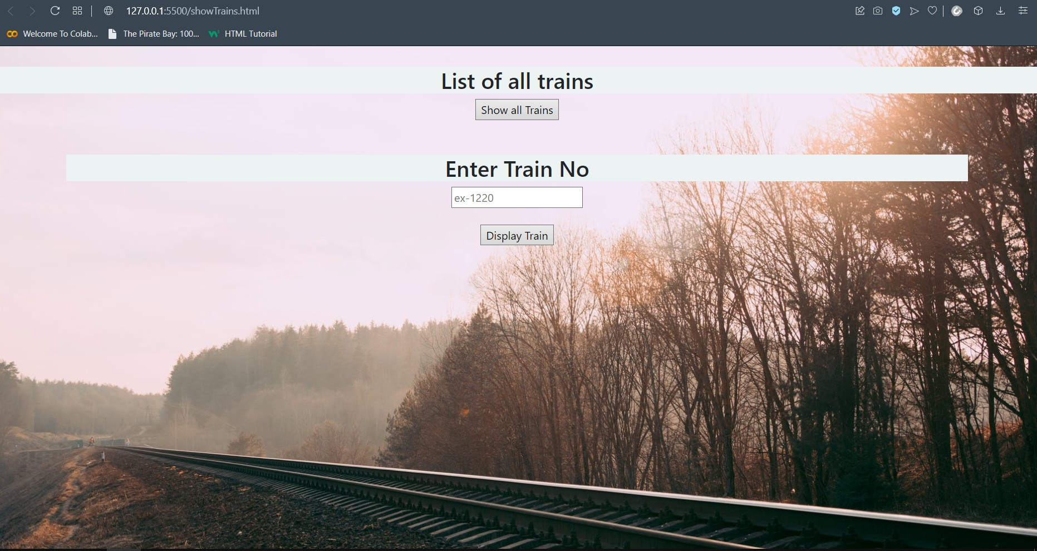

Slide 12
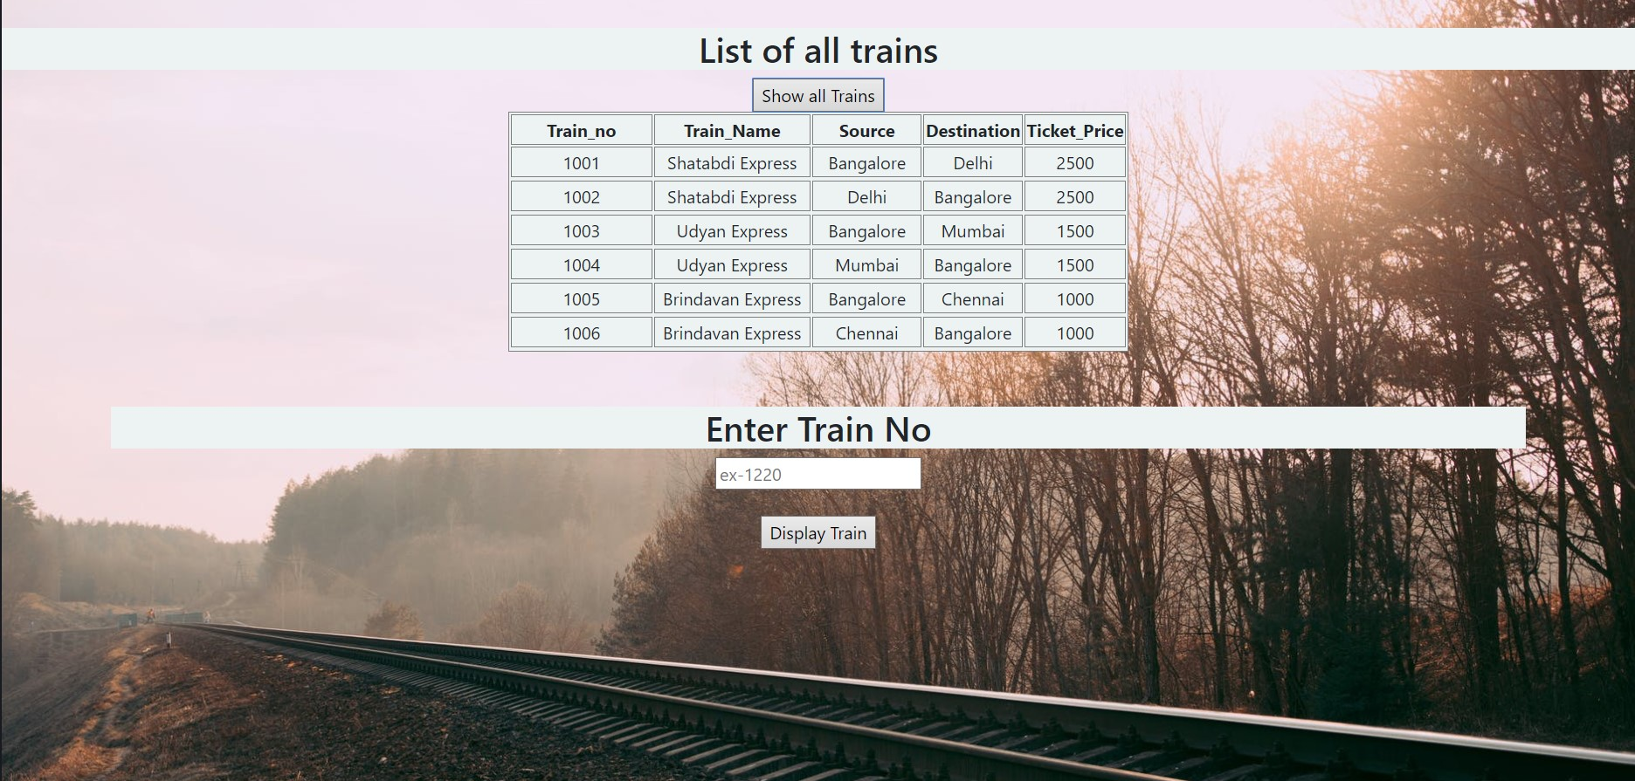

Slide 13
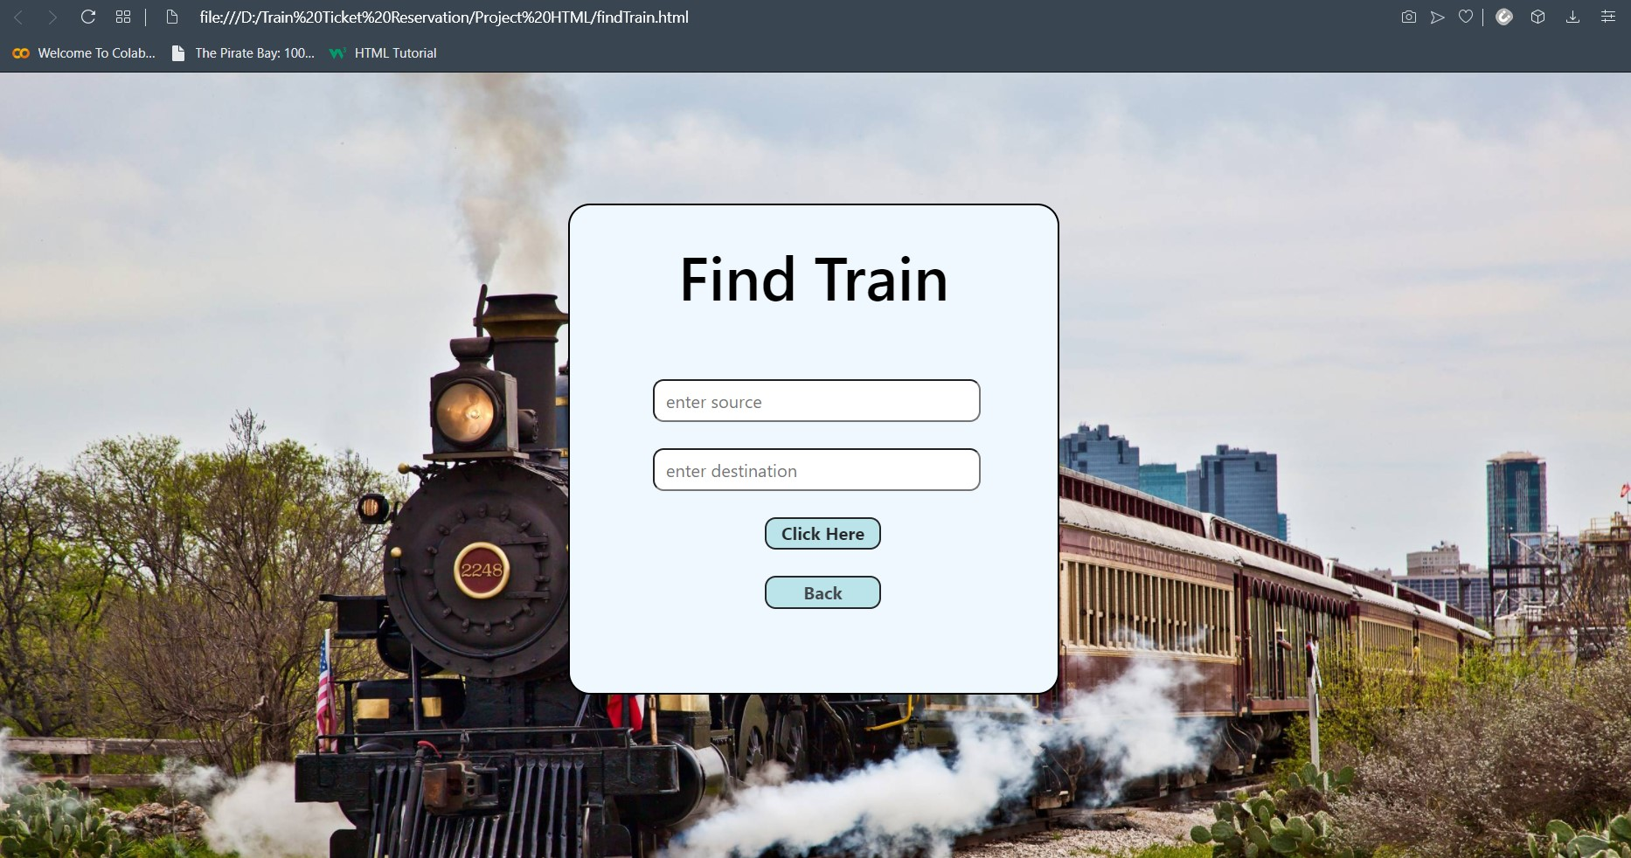

Slide 14
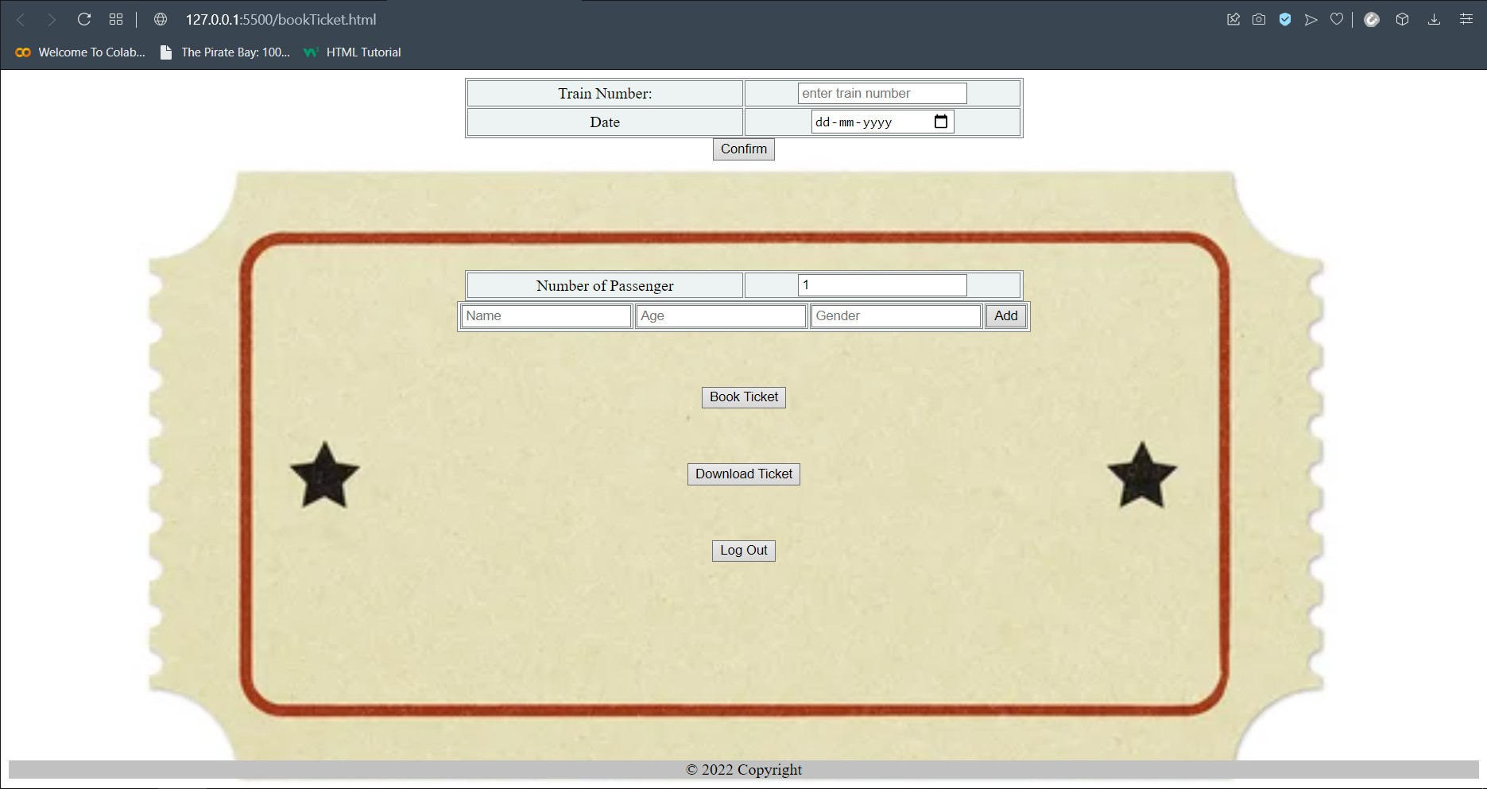

Slide 15
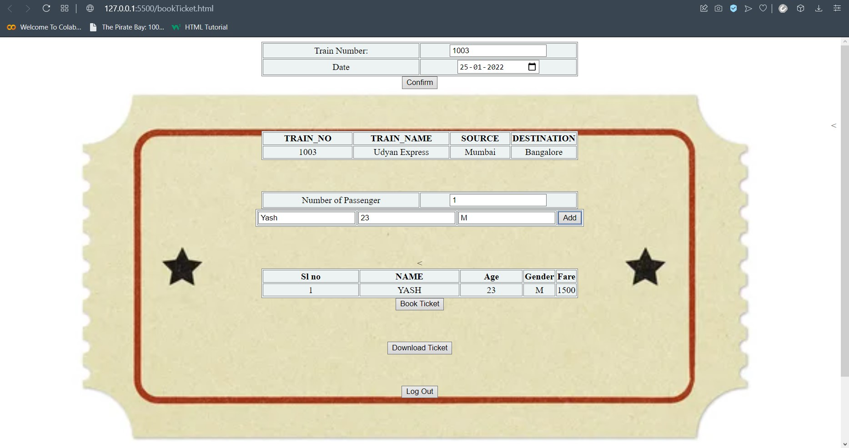

Slide 16
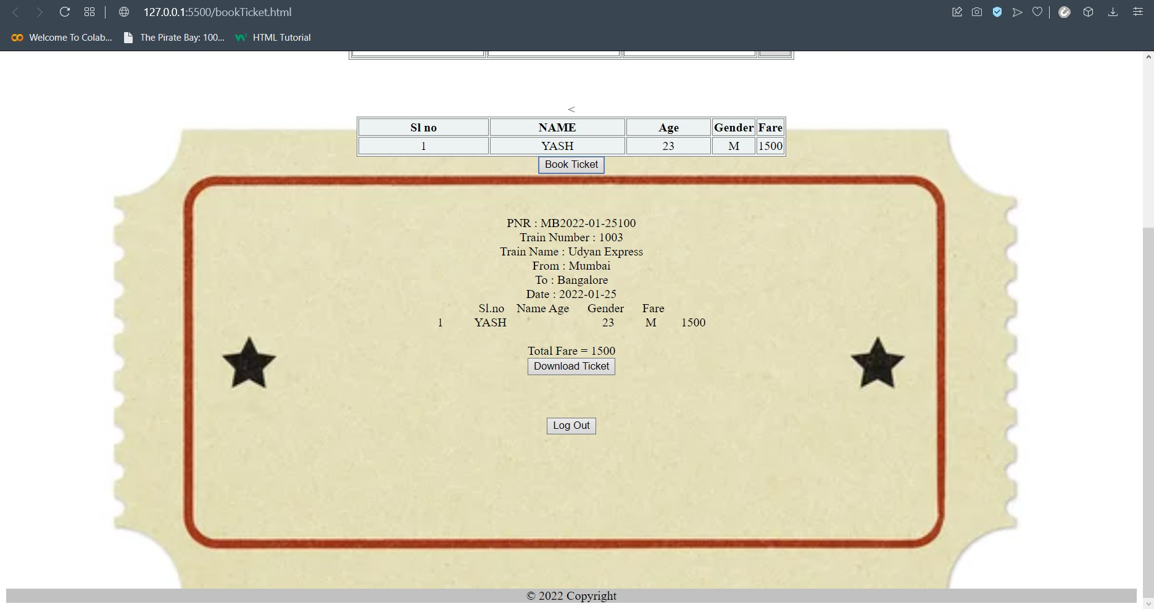

Slide 17
CONCLUSION
The purpose of this project is to build and program an application in such a way that it becomes easier for the travelers to book tickets online at any time & from any where.
It Eliminates the manual errors completely and also reduces the stress on the Train and Booking Management System offline.

Slide 18
FUTURE ENHANCEMENT
More Facilities and features could be added to make it an advanced Railway Reservation System.
A database can be added to the check availability of seats which are available after the cancellation of ticket on that specific train.

Slide 19
THANK YOU !!!

